Slide 1
Secure Data Hiding in Image Using Steganography
CAPSTONE PROJECT
Presented By: HRITIK RANJAN
Student Name : HRITIK RANJAN
College Name & Department : BTECH-CSE

Slide 2
OUTLINE
Problem Statement
Technology used
Wow factor
End users
Result
Conclusion
Git-hub Link
Future scope

Slide 3
Problem Statement
In today's digital era, the security of sensitive information has become a major concern. Traditional encryption methods can be detected, leading to potential attacks. Steganography offers a more covert way of securing data by embedding it within an image. This project aims to implement a secure image steganography technique to hide confidential data inside images, ensuring both secrecy and integrity while being resistant to unauthorized access.

Slide 4
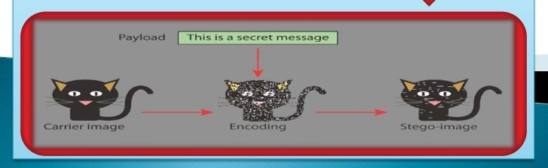
EXAMPLE
There are many ways to conceal information using Steganography. The most common method is by embedding information into digital images.
We all know that digital images say, a JPEG image, contains several megabytes of data in the form of pixels.

Slide 5
Technology used
Programming Language: Python
Libraries: OpenCV, NumPy, PIL (Pillow), Stegano
Encryption: AES (Advanced Encryption Standard)
Graphical User Interface (GUI): Tkinter
Image Processing: LSB (Least Significant Bit) Technique

Slide 6
Wow factors
Dual Security Mechanism: Integrating both steganography and encryption (AES) to enhance data protection.
Multi-Image Embedding: The ability to split data across multiple images for enhanced secrecy.
User-Friendly Interface: A GUI for seamless interaction.
Robust Against Attacks: The encoded image appears unchanged to human eyes and does not raise suspicion.

Slide 7
End users
Government and Intelligence Agencies: Secure communication of confidential information.
Corporate Sector: Secure transmission of sensitive business documents.
Individuals: Protecting personal data from unauthorized access.
Cybersecurity Professionals: Implementing secure data-sharing mechanisms.

Slide 8
Results

Slide 9
Decode

Slide 10


Slide 11
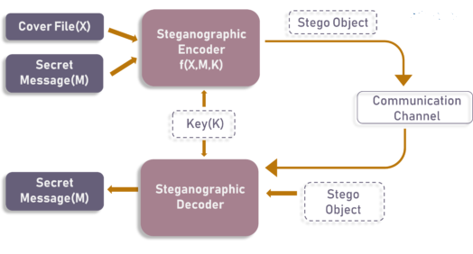

Slide 12
Conclusion
The project demonstrates an efficient and secure way to hide data within images using steganography. By integrating encryption techniques, we ensure that even if the hidden data is extracted, it remains unreadable without the correct decryption key. This method provides an effective and covert means of secure communication, suitable for various high-security applications.

Slide 13
GitHub Link
https://github.com/hritikranjan1/image_steganography.git

Slide 14
Future scope(optional)
Integration with Blockchain: Enhance security by verifying image authenticity using blockchain.
AI-based Steganalysis Detection Prevention: Implement AI techniques to resist steganalysis attacks.
Support for Various File Formats: Extend support beyond images to audio and video files.
Cloud-Based Steganography: Implement secure cloud storage for hidden data sharing.
Enhanced Embedding Techniques: Explore DCT (Discrete Cosine Transform) and DWT (Discrete Wavelet Transform) for better security.

Slide 15
THANK YOU

